Slide 1
Kisan Sahayata Portal
An Integrated Digital Support Platform for Farmers
By: Kandhikonda Sai Rishitha (1602-24-737-100)
J. Vaishali (1602-24-737-313)

Slide 2
Introduction
• Kisan Sahayata Portal is a digital solution designed to support farmers by integrating agricultural, financial, and market information in one platform.
• Each farmer is assigned a unique ID to manage their land, crop, and loan data securely.
• The portal bridges the gap between farmers, government schemes, and market trends — empowering them with timely decisions and better income opportunities.

Slide 3
Key Features
• Farmer Registration and Login System with unique ID
• Crop and Land Management with soil type and seasonal data
• Market Price and Fertilizer Availability Dashboard for informed decision-making
• Loan and Subsidies Modules with eligibility information
• Files for secure data storage

Slide 4
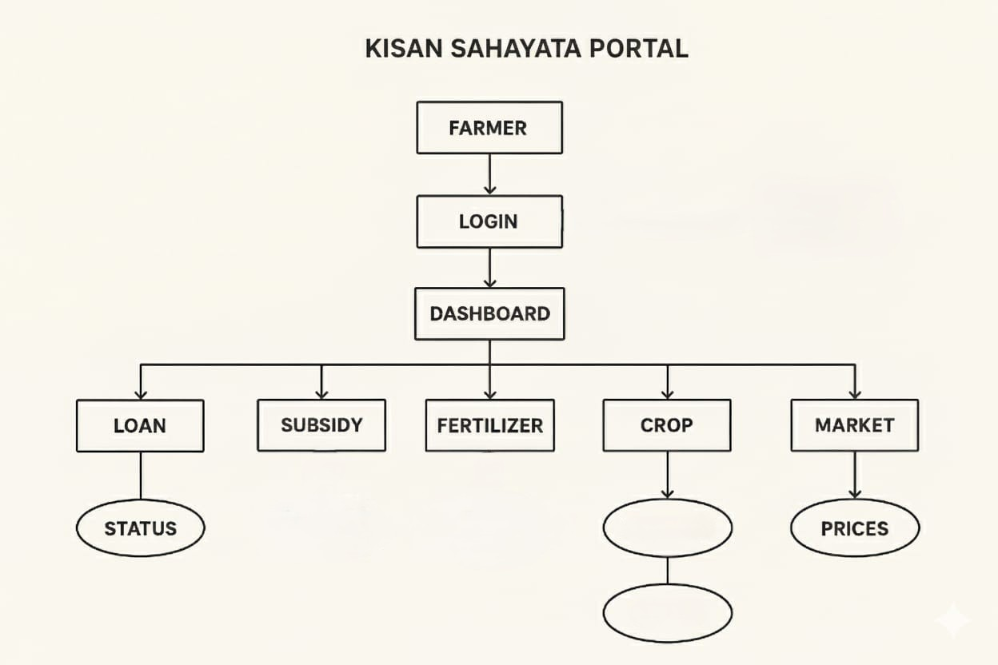
NOTIFICATIONS
CROP NAME&
SOIL TYPE
NO. OF DAYS TO HARVEST & TIPS

Slide 5
CLASSES
Farmer
(to store Farmer details)
String farmerID;
int age;
String name, village, soilType, username, password;
double landSize;
long aadharNum;
AccessAndSaveFarmer
(to access farmer details based on their ID, to save the modified/new farmer details, to generate unique ID for new farmers)
Loan
(to store the loan details)
String loanId, loanName, eligibility, documents;
LoanApplication
(to store the loan application details of a farmer)
String farmerId, LoanId, Status

Slide 6
CLASSES
ApplyAndSaveLoan
(to access the loan details, to apply a new loan and to save the loan applications)
Notification
(to store the generated notifications)
LoanNotification extends Notification
(to send the notification after a loan is applied)
String loanId, loanName, eligibility, documents;
NotificationManager
(to store and retrieve the previous notifications of the farmer)
NotificationThread
(to generate notifications of the loan and market price check using multi threaded programming)
MarketPrice
(to store the crop and its price per quintal)
String crop;
double price

Slide 7
CLASSES
MarketPriceManager
(to save and retrieve the market prices of each crop)
MarketPriceThread
(to update the price of each crop in the background using multi threaded programming)
Crop
(to store the crop details)
String name, season, fertilizer, tip;
int daysToHarvest;
RabiCrop extends Crop
(to store the Rabi Crops)
KharifCrop extends Crop
(to store the Kharif Crops)
CropInfoManger
(gives all the crop details along with its current price)
Classes for GUI of each feature

Slide 8
Advanced Add-ons and Future Enhancements
• Weather and Climate API Integration to provide crop and irrigation alerts
• Soil Health Reports and Smart Crop Recommendations
• Predictive Yield Analytics based on past data and rainfall
• Marketplace Integration to connect farmers directly with buyers
• Data Privacy improvement
• Sustainability Index for tracking water usage and eco-friendly practices

Slide 9
Conclusion
• Kisan Sahayata Portal aims to digitally empower farmers through data-driven insights and easy access to government and market resources.
• The project showcases the application of Object-Oriented Programming concepts in Java through a real-world use case.
• Future enhancements can expand the portal into a complete digital ecosystem integrated with national initiatives like AgriStack and eNAM.
“Technology for Empowered Agriculture”

